Slide 1
EQUIPMENT BOOKING SYSTEM
23CDR033 Dhanushri M
23CDR043 Divya C S

Slide 2
PROBLEM STATEMENT
Organizations often face issues managing shared equipment like laptops or projectors due to lack of a centralized system, leading to conflicts and poor utilization. A web-based Equipment Booking System is needed to allow users to view, reserve, and manage equipment efficiently while preventing double bookings and maintaining proper records using Python and an RDBMS.

Slide 3

MODULES
1
User Authentication Module
2
Equipment Management Module
3
Booking Module
4
Dashboard Module
4
Notification & History Module

Slide 4









NOTIFICATION & HISTORY
EQUIPMENT MANAGEMENT
Alerts on booking, cancellation, return reminders
Booking history for users
Add, update, delete equipment (admin)
View available equipment (users)
Equipment status (Available, Booked)
USER AUTHENTICATION
Login and registration
Role-based access (User/Admin)
Session handling and security
BOOKING
DASHBOARD
View available time slots
Reserve equipment
Prevent double booking
Modify or cancel bookings
User Dashboard: Past bookings
Admin Dashboard: monitor all reservations, manage users

Slide 5

1
USER TABLE
user_id (Primary Key) – varchar
name – varchar
email – varchar
role – varchar (e.g., 'admin', 'user')
password – varchar

Slide 6
2
EQUIPMENT TABLE
Stores equipment records.
equipment_id (Primary Key) – varchar
name – varchar
status – varchar(e.g., 'available', 'booked', 'maintenance')
location – varchar
category – varchar(e.g., 'projector', 'laptop')

Slide 7
3
RESERVATION TABLE
reservation_id (Primary Key) – varchar
user_id (Foreign Key → users.user_id) – varchar
start_time – timestamp
end_time – timestamp
status – varchar (e.g., 'confirmed', 'cancelled')
equipment_id (Foreign Key → equipment.equipment_id) – varchar

Slide 8
4
EQUIPMENT MAINTENANCE TABLE
Logs maintenance records for equipment.
maintenance_id (Primary Key) – varchar
reported_by (Foreign Key → users.user_id) – varchar
equipment_id (Foreign Key → equipment.equipment_id) – varchar
issue_description – varchar
maintenance_date – date
status – varchar(e.g., 'pending', 'resolved')

Slide 9
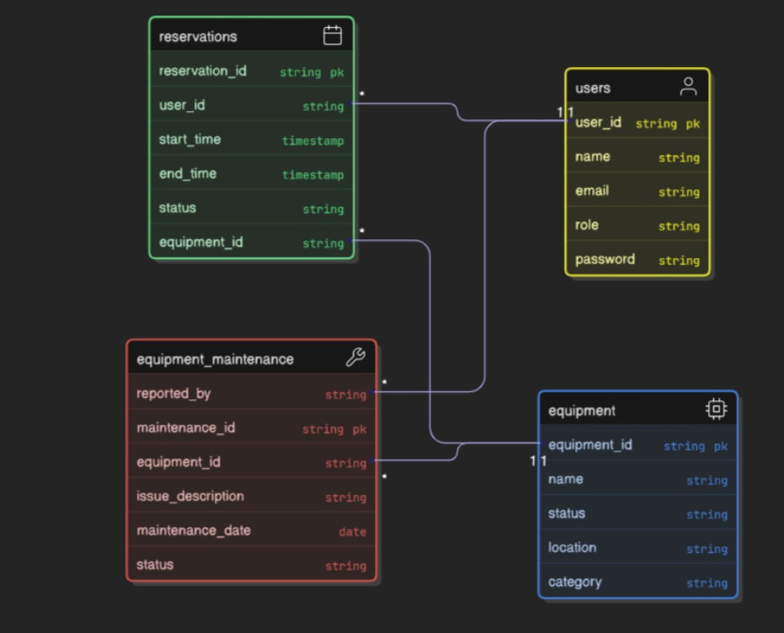
DATA MODEL

Slide 10
TOOLS USED
FRONTEND
Html , CSS , Bootstrap , JavaScript
BACKEND
Python , Flask , Mysql

